Slide 1


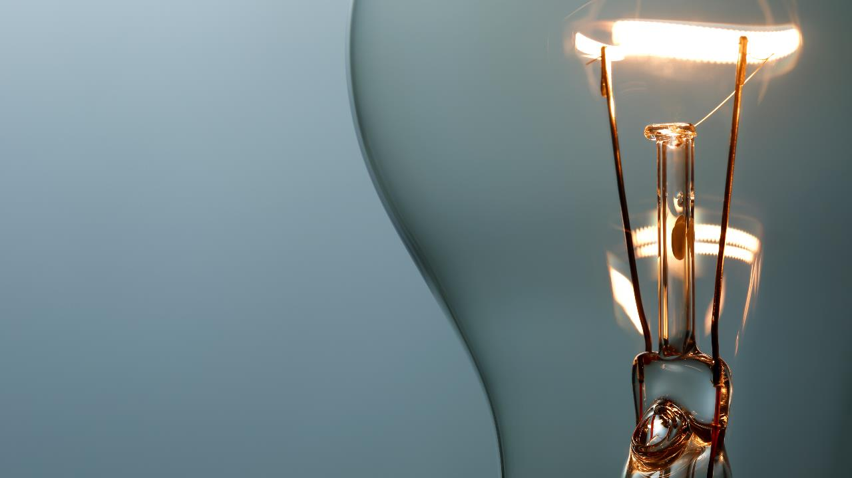
The FIVE senses
Presented By Junaid

Slide 2

Five SENSES table
Sense | Body Part | Use (%)
👁️ Sight | Eyes | 75%
👂 Hearing | Ears | 13%
✋ Touch | Skin | 6%
👃 Smell | Nose | 3%
👅 Taste | Tounge | 3%

Slide 3
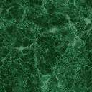
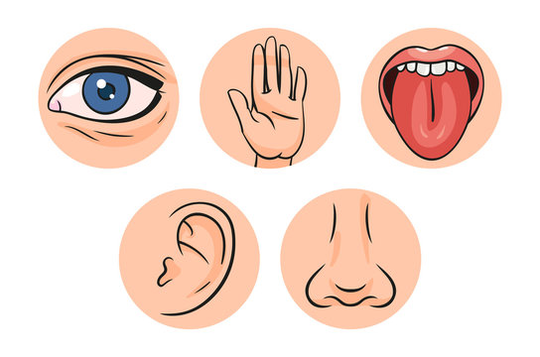
What are five SENSES
There are five senses in every living things
Eyes
Nose
Ears
Tounge
Skin

Slide 4
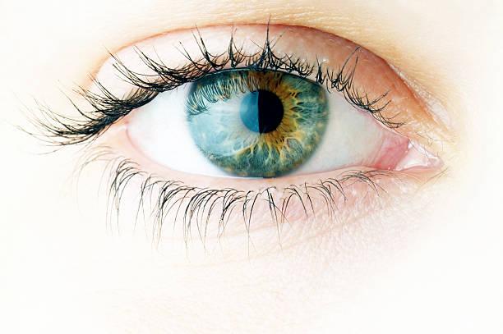
Senses Of Sight (EYES)
.
Importance of Eyes
Eyes help us see things.
We can see colors, people, animals, and objects.
Without eyes, life would be very hard.
🌟 Fun Fact:
Our eyes can see millions of colors!
Without Eyes we can’t see anything

Slide 5
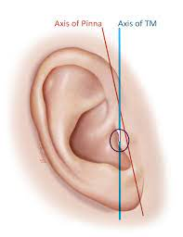
Sense of hearing(ears)
.
Importance of Ears
🌟 Fun Fact:
Our ears never stop working, even when we sleep!
Ears help us hear sounds.
We can hear people talking, music, animals, and traffic.
Ears help us to learn, talk, and stay safe.
Ears also help us keep balance so we don’t fall.

Slide 6
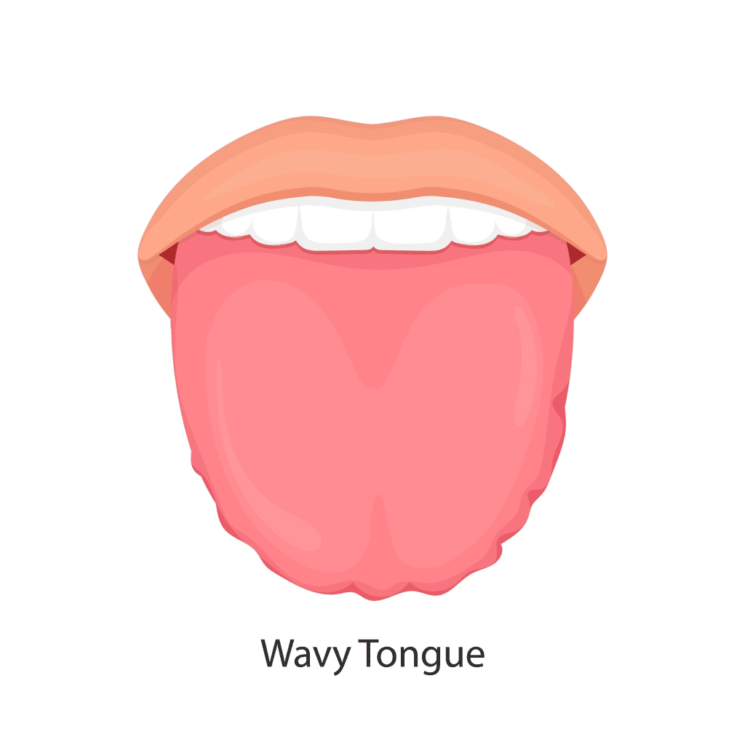
Senses OF TASTE (TOUNGE)
.
Importance Of Taste
. Our tongue helps us taste food.
We can taste sweet, salty, sour, bitter, and spicy.
Taste helps us enjoy food and know what we like.
It also helps us know if something is bad or spoiled.
🌟 Fun Fact:
The tongue has about 10,000 taste buds!

Slide 7
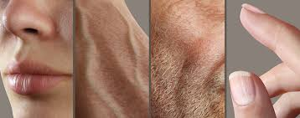
Sense Of Touch (SKIN)
.
Importance Of Touch
We feel thing use use our skin to
It helps us stay safe, like pulling away from something hot.
Touch also helps us feel pain, pressure, and comfort (like a hug).
🌟 Fun Fact:
The skin is the largest organ in the human body!

Slide 8
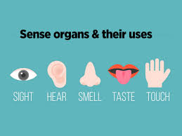
Why SENSES are Important
The five senses help us understand the world around us.
They let us see, hear, smell, taste, and feel.
Senses help us stay safe (like hearing a car or feeling something hot).
They help us learn, play, eat, and talk to others.
Without our senses, we wouldn’t know what’s happening around us.
🌟 Fun Fact:
Babies start using their senses before they are born!

Slide 9
Fun FACTS about five senses
Our eyes can see millions of colors!
Without Eyes we can’t see anything
Our ears never stop working, even when we sleep!
The tongue has about 10,000 taste buds!
The skin is the largest organ in the human body!
Babies start using their senses before they are born!

Slide 10
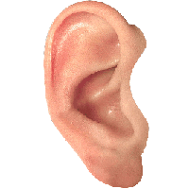
Process
Eyes
Tounge
Touch
Nose
Ears

Slide 11
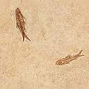
Graph of five senses

Slide 12
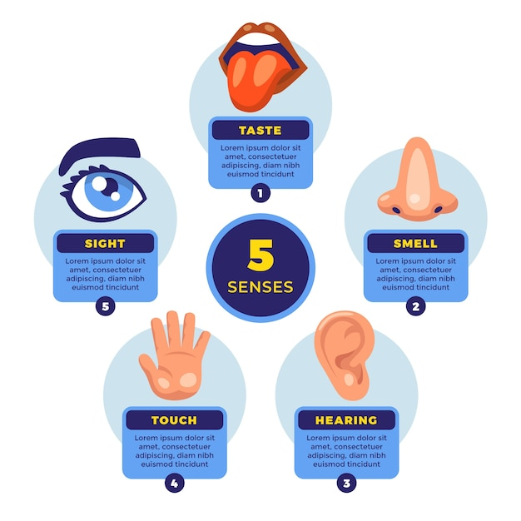
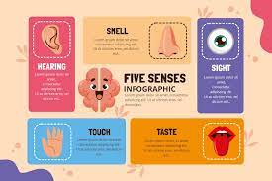
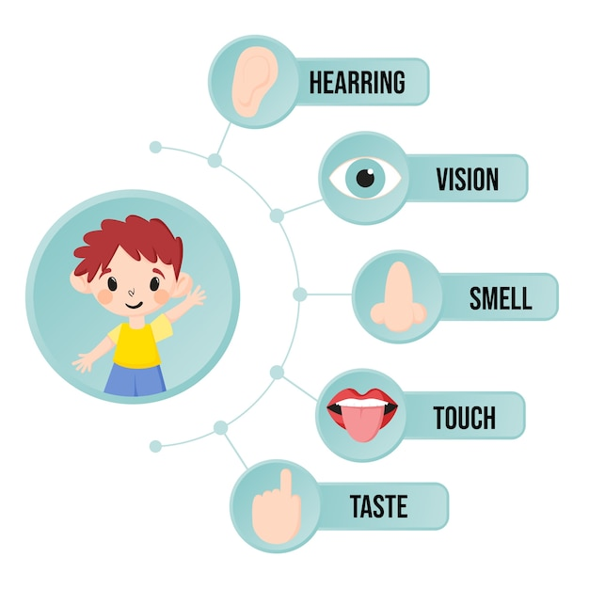
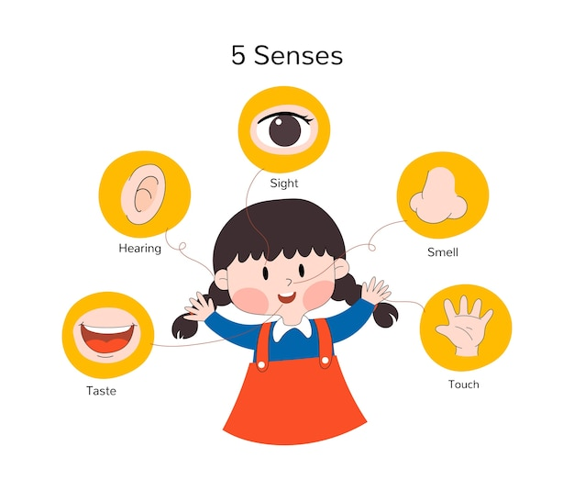
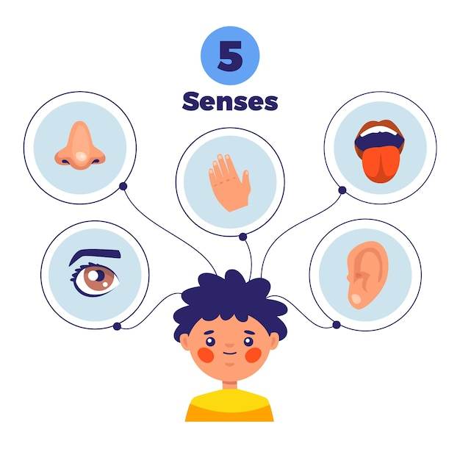


Slide 13
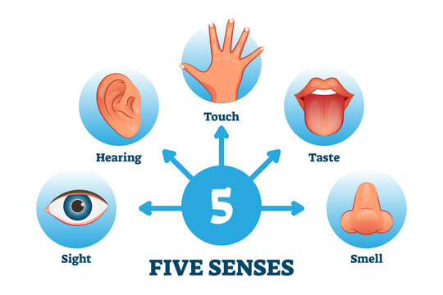
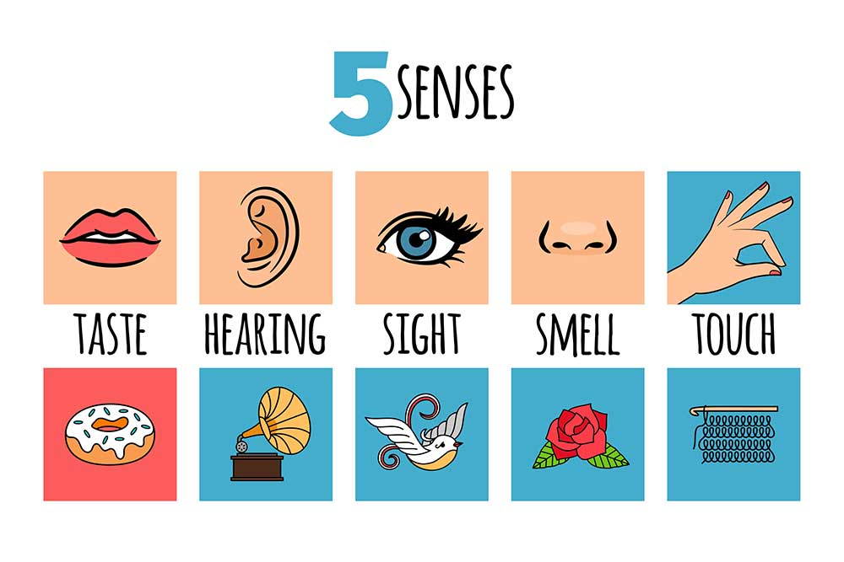
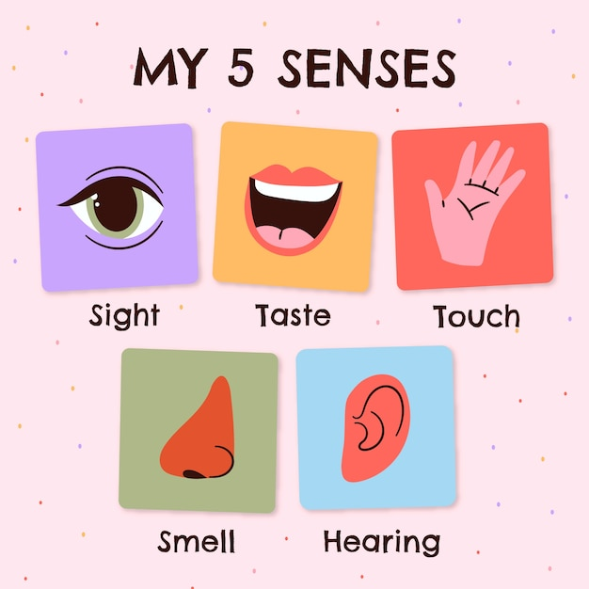
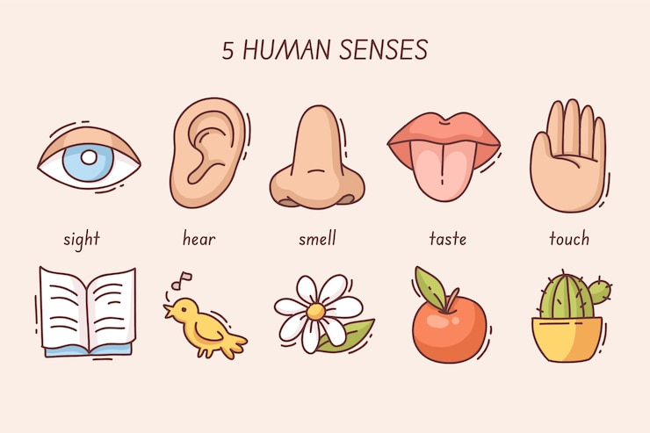

Slide 14
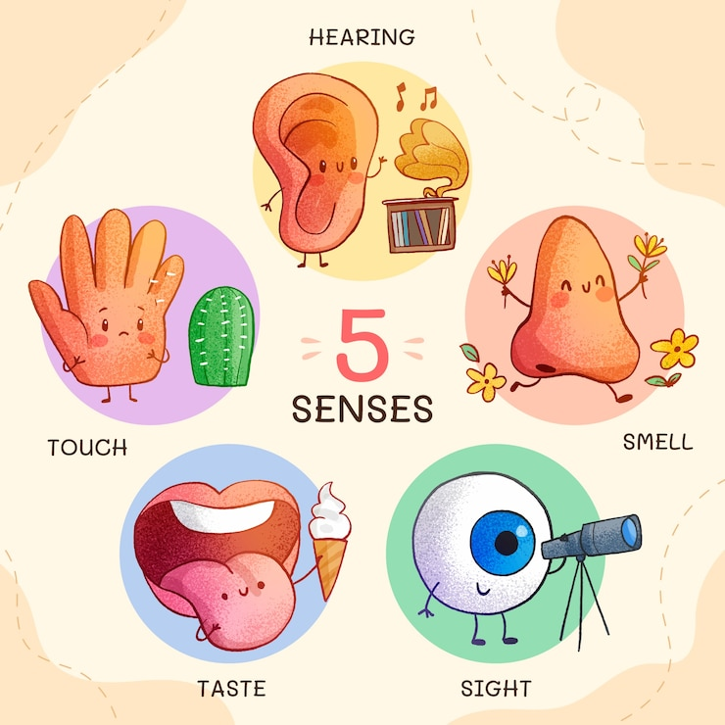
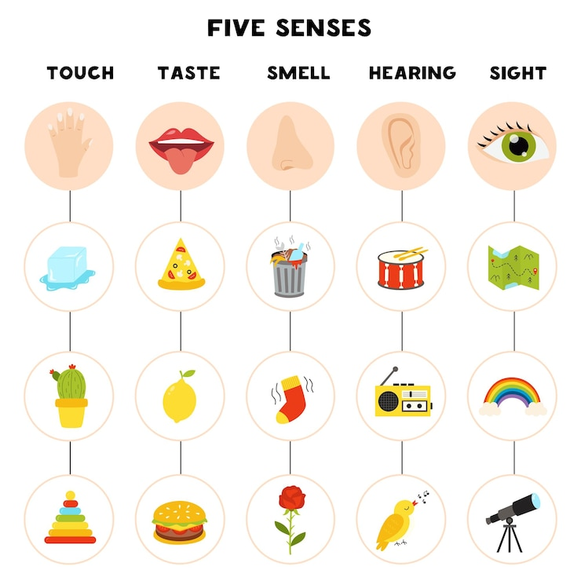

Slide 15
